Slide 1
Web and mobile app development – csc3054/7054
6.2 Google maps application

Slide 2
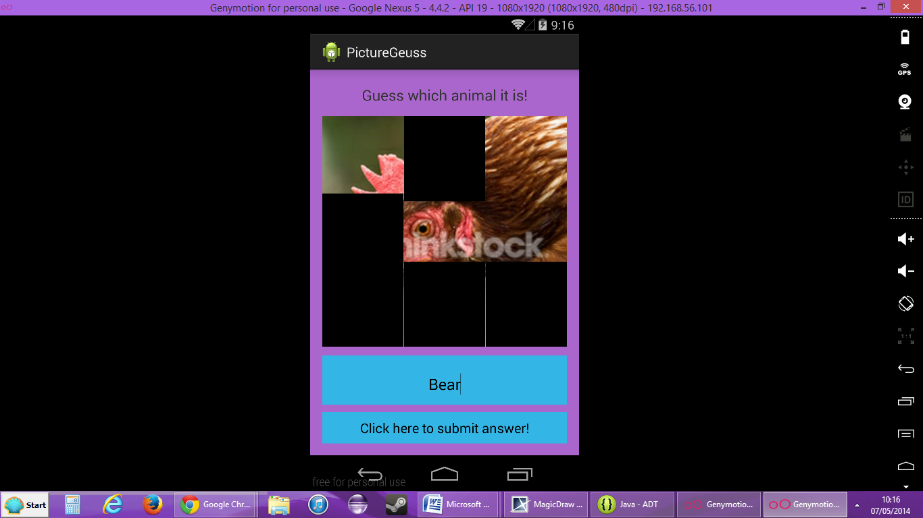
“picture guess” application
To design a game for use as an educational multimedia took in teaching young children.
Text input is used to guess what is in a picture, which is revealed one square/rectangle at a time if the answer is wrong.

Slide 3
What we discussed in the last lecture?
SQLite basics
Created a SQLite database

Slide 4
Questions to be answered
How are we going to install google play services api?
How to link google play services api with an app?
How to create google maps api key?

Slide 5
Content outline
Download google play services
Make google play services ready to use
Obtain the google maps api key
Summary
Next lecture
Further readings

Slide 6
why google play services
To update Google apps.
To provide core functionalities like authentication and synchronisation.

Slide 7
google play services
Open Android Studio.
Create a new project named “GoogleMaps”.
On the panel, click Tools → Android.
Choose SDK Manager.
On the left column of the window, choose Appearance & Behaviour → System Settings → Android SDK.
On the right column of the window, click SDK Tools.
Check Google Play Services and Apply for installation.
Click OK to finish.

Slide 8
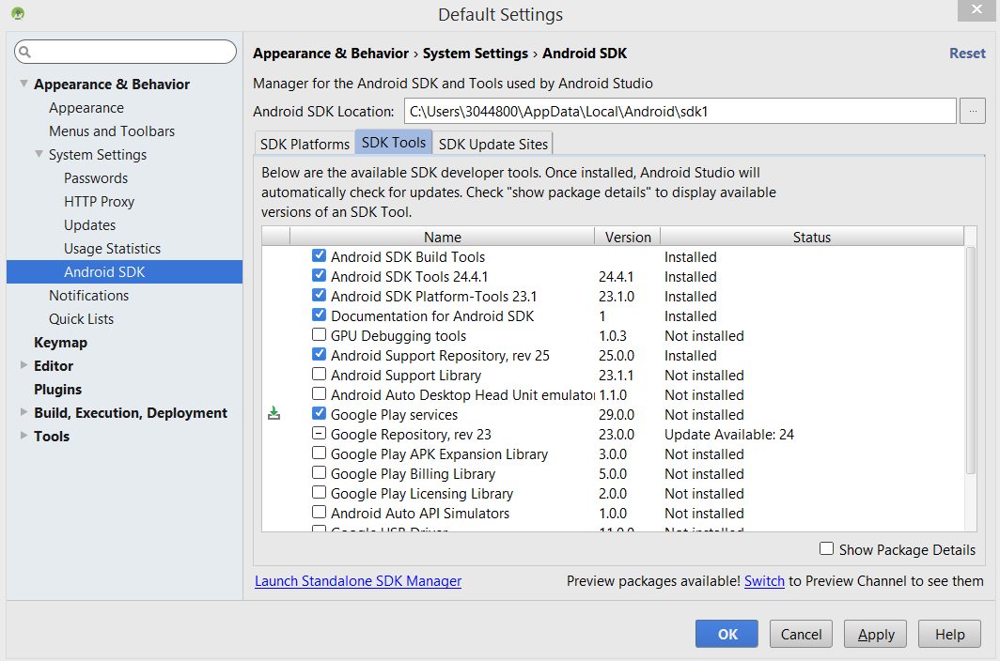
install google play services

Slide 9
Content outline
Download google play services
Make google play services ready to use
Obtain the google maps api key
Summary
Next lecture
Further readings

Slide 10
Android studio with google play services
Go to the Android Studio panel.
On the left column, choose: Gradle Scripts (what is its role?).
Double click: build.gradle (Module: app).
Add a new build rule under “dependencies” for the latest version of pay-services. For example, add the following line after “…appcompat-v7:23.1.1”: compile ‘com.google.android.gms:play-services:8.3.0’
Save the changes and a message pops up to ask for “Sync Now”. Click on the button to the left of the AVD Manager on the panel.

Slide 11
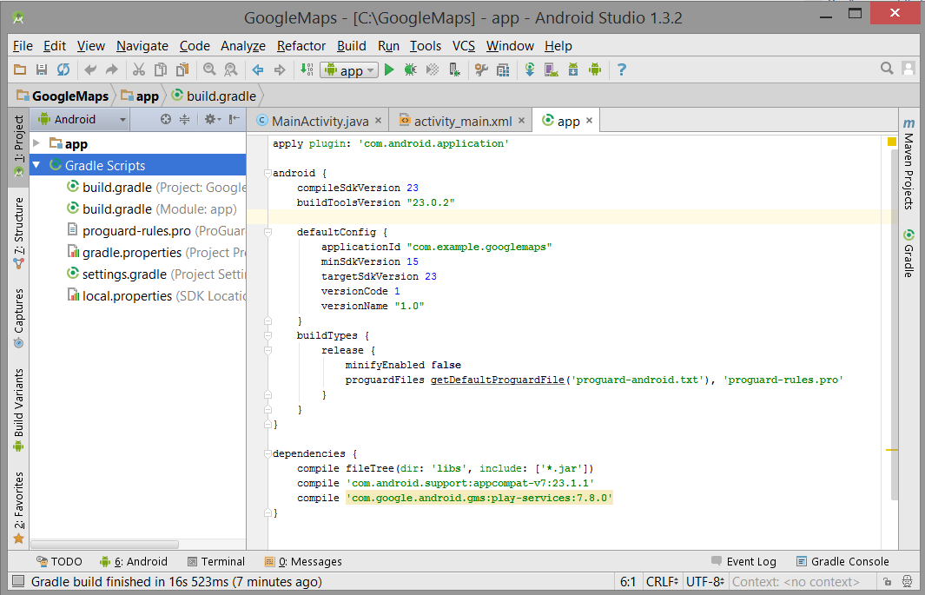
after google play services is added

Slide 12
Another way to add google play services
Go to File → Project Structure.
Go to Modules app.
Select 'Dependencies' Tab.
Click '+' and select '1. Library Dependencies'.
Search for : com.google.android.gms:play-services.
Select the latest version and click 'OK'.

Slide 13
Content outline
Download google play services
Make google play services ready to use
Obtain the google maps api key
Summary
Next lecture
Further readings

Slide 14
why the google maps api key
This is used to authenticate the app for accounting purposes.

Slide 15
Obtain the google maps api key
Open terminal of MS-DOS by right-clicking on the Start button and then choosing Command Prompt.
C:>cd Program Files\Java\jdk1.7.0_xx\bin.
Run the following command: keytool -list -v -keystore “C:\Users\3044800\.android\debug.keystore" -alias androiddebugkey -storepass android -keypass android
This operation allows us to obtain SHA1 key: see the figures…
(SHA1 – Signing certificate fingerprint)

Slide 16
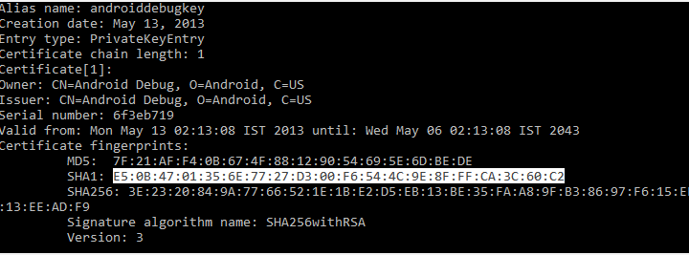
Obtain the google maps api key

Slide 17
Obtain the google maps api key
We now attempt to get Google Maps API Key.
Open Google API Console (code.google.com/apis/console)
Click Create project button.
Type in Google Maps.
API Enable and manage APIs.
Choose Google APIs.
Type in Google Maps Android API.
Choose Google Maps Android API.
Click Enable API.
Click on Go to Credentials.
Click on New credentials → API key.
Choose Android key.
Click +Add package name and fingerprint. Fill in package name and SHA-1 code.
Then Create.

Slide 18
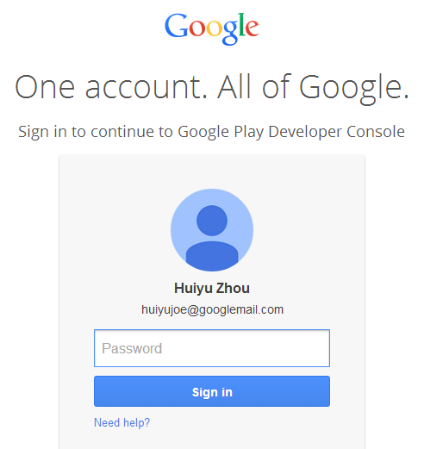
Obtain the google maps api key
Open Google API Console

Slide 19
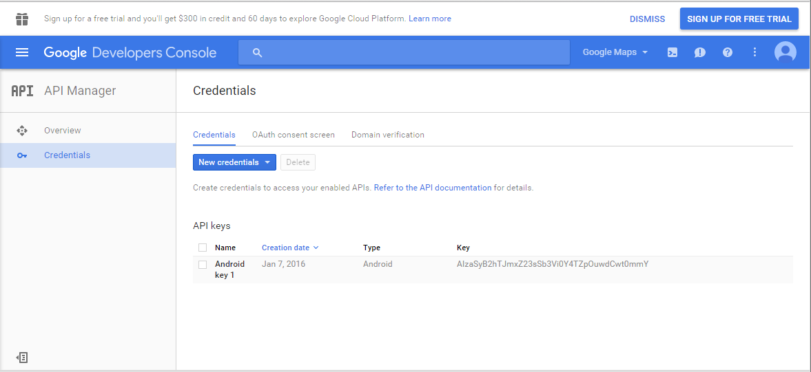
Obtain the google maps api key
Note down the API key which is required later in the project creation.

Slide 20
Content outline
Download google play services
Make google play services ready to use
Obtain the google maps api key
Summary
Next lecture
Further readings

Slide 21
Summary
Installed google play services api.
Linked google play services api with an app.
Created a google maps api key.

Slide 22
Content outline
Download google play services
Make google play services ready to use
Obtain the google maps api key
Summary
Next lecture
Further readings

Slide 23
next lecture
To carry on the google maps app.

Slide 24
Content outline
Download google play services
Make google play services ready to use
Obtain the google maps api key
Summary
Next lecture
Further readings

Slide 25
Further readings
http://developer.android.com/training/index.html
Android Application Development for Dummies, Donn Felker, Wiley Publishing, Inc., NJ, 2011.
https://developers.google.com/maps/documentation/android/start?hl=zh-TW

